Slide 1
KIVA Introduction NETLOGO
Muhammad Ryanda Nugraha M.
14 December 2020
Industrial Management Department
Center for Internet of Things Innovation
National Taiwan University of Science and Technology

Slide 2
Check Points

Slide 3
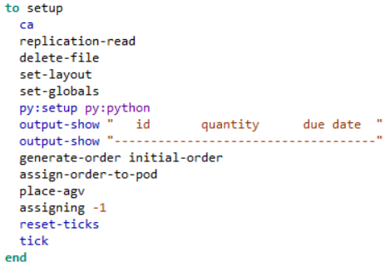


Setup
CODE
Setting up the Simulation
PROCESS FLOW
Go
Replication-read
CODE EXPLAINATION
Set-layout
Delete-file
Ca :
Replication-read : Call function for read replication
Delete-file : call function for delete file
Set-layout : call function for setting layout
Py:Setup : Setting up python for netlogo
Set globals
Py:setup

Slide 4
SETUP
CODE
DICTIONARY
Ca : Cellular automaton model
Py:setup py:python : setup python
Output-show : show output
Reset-ticks : reset ticks
Tick : initialize ticks
CODE EXPLAINATION
Ca :
Replication-read : Call function for read replication
Delete-file : call function for delete file
Set-layout : call function for setting layout
Py:Setup : Setting up python for netlogo

Slide 5

Replication-read
CODE
Read replication
PROCESS FLOW
Go
carefully
CODE EXPLAINATION
Set replication
Let rep_ item
Create temporary variable for saving “replication.csv” and then reset the value of the variable to 0

Slide 6
Replication-read
CODE
DICTIONARY
Carefully [ commands1 ] [ commands2]: Runs commands1. If a runtime error occurs inside commands1, NetLogo won't stop and alert the user that an error occurred. It will suppress the error and run commands2 instead.
Let : initialize variable value
Set : set variable value
Item 0 : item on index 0
Csv: from-file : get item from csv file
CODE EXPLAINATION
Create temporary variable for saving “replication.csv” and then reset the value of the variable to 0

Slide 7
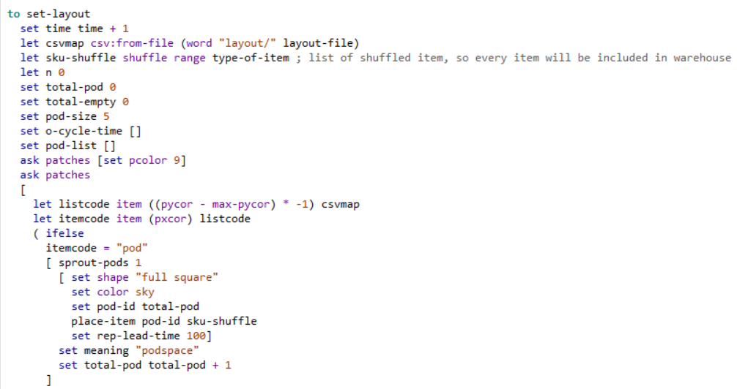
Set-layout
CODE
Setting up the Simulation’s layout
A
CODE EXPLAINATION
B
A Section : Setting up / initialize variables and array(time,sku-shuffle,n, total-pod, total-empty, pod-size, o-cycle-time[], pod-list[]) also open csv file from “Layout” repo
B section : - Ask patches[set pcolor] : Set base color to 9 - let listcode item ((pycor - max-pycor) * -1) csvmap : initialize listcode based on csvmap variable value - let itemcode item (pxcor) listcode : initialize itemcode varible based on listcode
C section : -if else itemcode = [string] : Conditional for checking item code
C
D
D section : sprout-pods 1 = create 1 pod set shape / set color = set shape and color set pod-id = set id for pod place-item : call place item function with pod-id and sku-shuffle set rep-lead-time 100 : set variable to 100 set meaning : initialize meaning set-total-pod total-pod+1 : increment for total pod

Slide 8
Set-layout
CODE
DICTIONARY
Ask patches … : Command every patches
Ifelse : Conditional if
Shuffle : shuffling list randomly
Range [range] : Generate list within\ range of [Range]
csv:from-file … : open csv file from given folder and its name
Word [value] : Declaring string with [value}
Sprout : Sprouting item (pod,empty,etc)
A
B
C
D

Slide 9
Set-layout (Cont)
CODE
Setting up the Simulation’s layout
CODE EXPLAINATION
Let que-size … : initialize que-size with turtle that have shape “int7” after sorted based on xcor minus picking-stations
Ask picking-stations… : call function picking-stations for set entering-que with xcor+que-size
Ask turtles … : Ask each turtle with shape “int7” to die

Slide 10
Set-layout (Cont)
CODE
Setting up the Simulation’s layout
DICTIONARY
sort : sorting list
sorting agentset
of : [reporter] of agent
[reporter] of agentset
with : agentset with [reporter]

Slide 11
Thank You
Ryanda
Industrial Management Department
Center for Internet of Things Innovation
National Taiwan University of Science and Technology

